Slide 1




R Programming Language
Module 04
R has a package called emojifont that allows users to use emojis in their R code and output? It even comes with its own font, designed by the creator of the package, which includes over 100 different emojis that can be used to add some personality to your
R code and results.

Slide 2


Class Objectives
1
Reinforce understanding of key R programming concepts
2
Effective data manipulation using `dplyr`
3
Guide students through creating meaningful data visualizations with `ggplot2`
4
Foster practical problem-solving skills

Slide 3
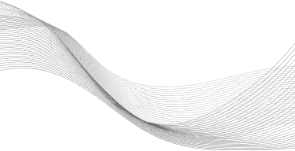
The R-factor
Unlocking Insights with Statistical Computing

Slide 4

Why R
Fast and flexible development environment
Large community of users and contributors
Extensive library support for various domains and tasks

Slide 5

Operators & Basic Calculations
In R, you can perform basic arithmetic operations such as addition, subtraction, multiplication, and division
Assignment Operator
x <- 5
y <- 10
sum <- x + y
Arithmetic Operators

Slide 6
Data Structures in R
Vectors, Data Frames, Lists, Matrices
# Vector
vector <- c(1, 2, 3)
# Data Frame
data <- data.frame(a = c(1, 2, 3), b = c('A', 'B', 'C'))
# List
list_example <- list(a = 1, b = "text")

Slide 7
Dates & Times in R
Dates and times are often tricky to handle, but in R, you have powerful tools to manipulate and format them
date <- as.Date("2025-01-14")

Slide 8
Reading Data in R
You can easily import data into R using functions like read.csv() or readRDS()
data <- read.csv("data.csv")

Slide 9
Data Manipulation with dplyr
The dplyr package in R provides a set of functions for efficiently manipulating and transforming data
Load the library
Pipe Operator
library(dplyr)
data_filtered <- data %>% filter(variable > 10)
data_mutated <- data %>% mutate(new_column = old_column * 2)
dplyr functions

Slide 10
Data Visualization with ggplot2
Data visualization is key to understanding and presenting your findings
ggplot2 makes it easy to create beautiful plots
library(ggplot2)
ggplot(data, aes(x = variable1, y = variable2)) + geom_point()

Slide 11

Guided Demo
WHO Life Expectancy Dataset (2000 - 2015)

Slide 12
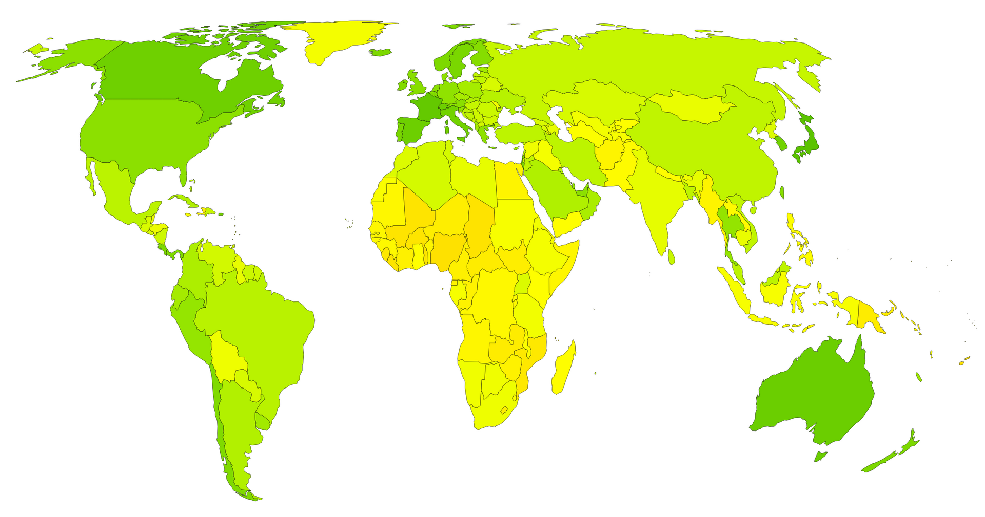
WHO Life Expectancy
The dataset is a comprehensive collection of health-related data from 2000 to 2015 for 193 countries, including life expectancy, immunization rates (e.g., Hepatitis B, Polio, Diphtheria), mortality factors, economic indicators (GDP), and social factors

Slide 13
Challenge
R-evolutionize Your Data Analysis
World Happiness Report 2023

Slide 14
R-evolutionize Your Data Analysis
World Happiness Report 2023
The World Happiness Report uses data from the Gallup World Poll to estimate happiness scores and rankings across 6 key factors: economic production, social support, life expectancy, freedom, absence of corruption, and generosity. These factors contribute to making life evaluations higher or lower in each country compared to Dystopia, a hypothetical baseline country with the world's lowest national averages for each factor.
Get this challenge’s files from Module 04 Live Lesson Challenge in Google Classroom

Slide 15
R-evolutionize Your Data Analysis
In this challenge you will:
Load the dataset and check its structure, summary statistics, and the first few rows.
Clean the data
Calculate average happiness scores
Create a visualization that compares the happiness scores
Perform Statistical Analysis
Get this challenge’s files from Module 04 Live Lesson Challenge in Google Classroom

Slide 16


Debrief
Let’s Review
R-evolutionize Your Data Analysis

Slide 17
Questions?

